Slide 1
Private Practitioner
______________________
ONLINE BOOKING SYSTEM

Slide 2
Private Practitioner
Problem: Practitioners who operate by themselves, are unable to take phone bookings whilst providing service to current customers.
Answer: Provide online booking system.

Slide 3
Booking System
Main features
Customer can choose type of treatment
Book an appointment
Get a text/SMS reminder sent to client’s phone.
Ability to change, cancel bookings.
Practitioner can view appointments every day and every week.
Practitioner controls which appointment dates and times can be booked.
Contact form and Map location supplied

Slide 4
Booking System
Non-MVP features (for later versions / development)
Ability to lock, view appointments per month
Ability to sell products through the site
Ability to pay for appointment online.
Practitioner to be emailed/notified when appointments are cancelled.
User history is retained, so that appointment frequencies and treatment types can be analysed.
Appointments can be filtered according to different criteria (eg. NHS funded, paid-for).
Appointment durations can be customised per practitioner
Scale to two or more practices/office locations in the same system.

Slide 5
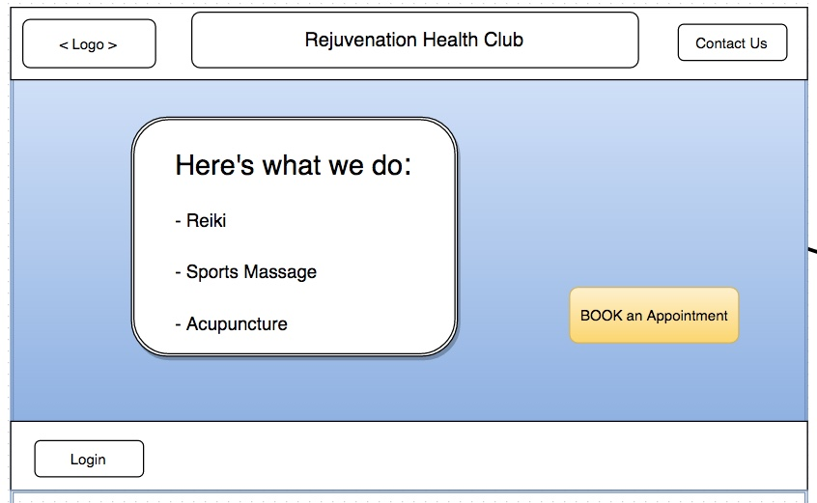
Opening Screen

Slide 6
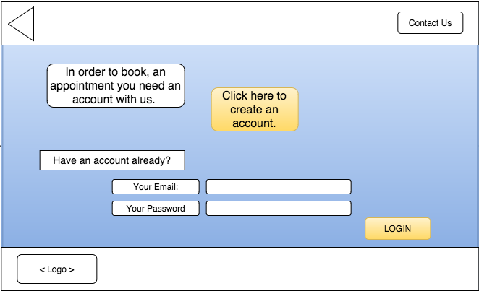
Create Account and/or login

Slide 7
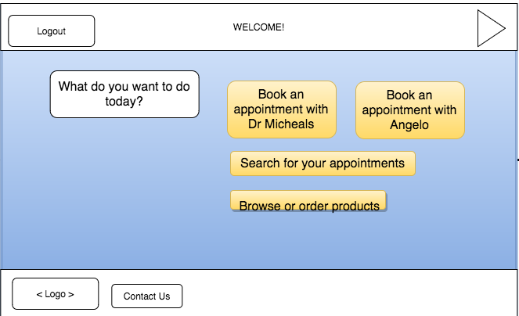
Choose action

Slide 8
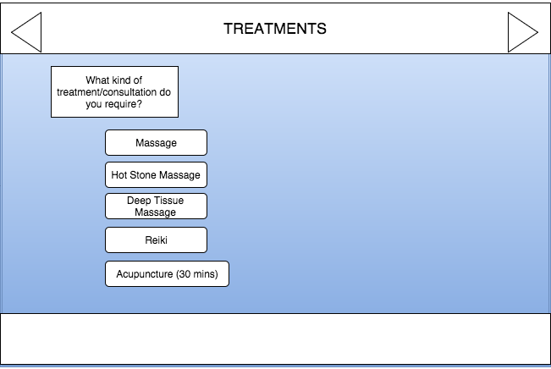
Choose type of appointment

Slide 9
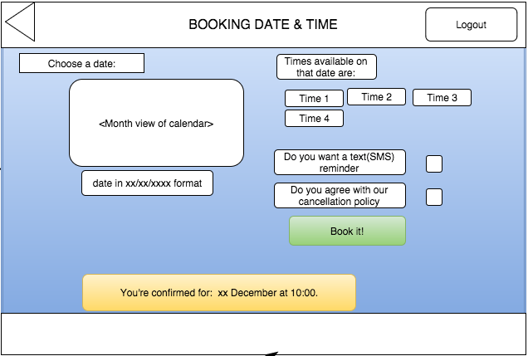
Choose Date & Time & Book it!

Slide 10
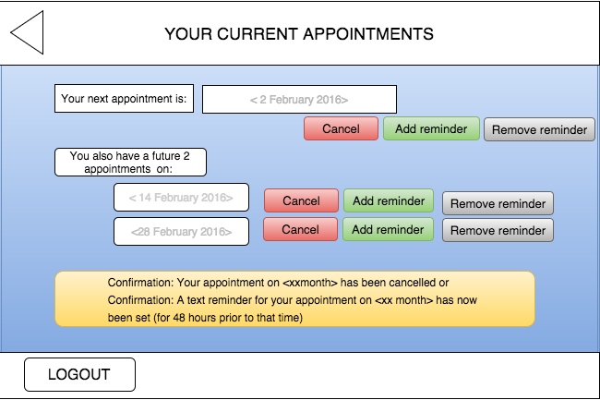
Lookup your appointment

Slide 11
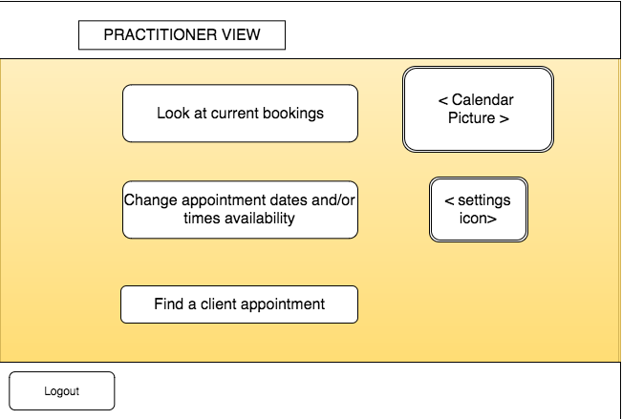
Practitioner’s Views

Slide 12
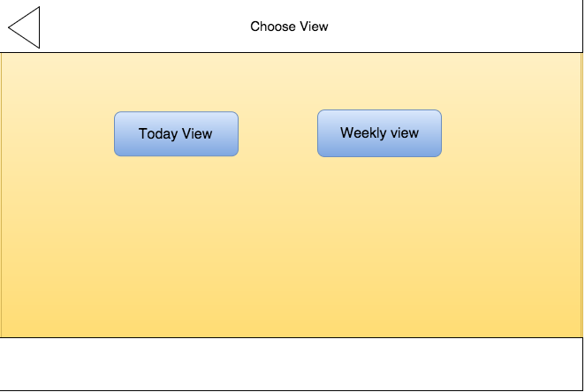

Slide 13
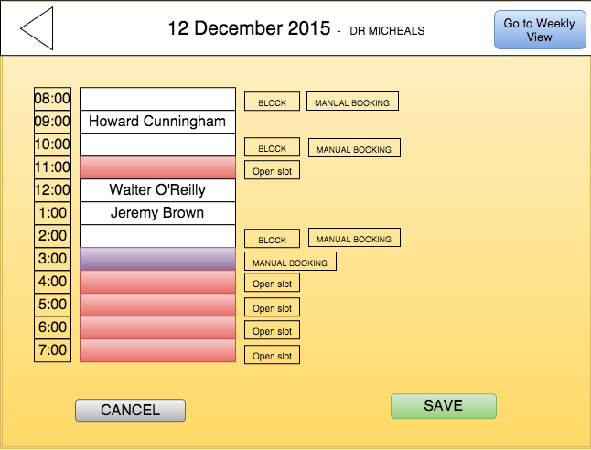
Daily view of appointments

Slide 14
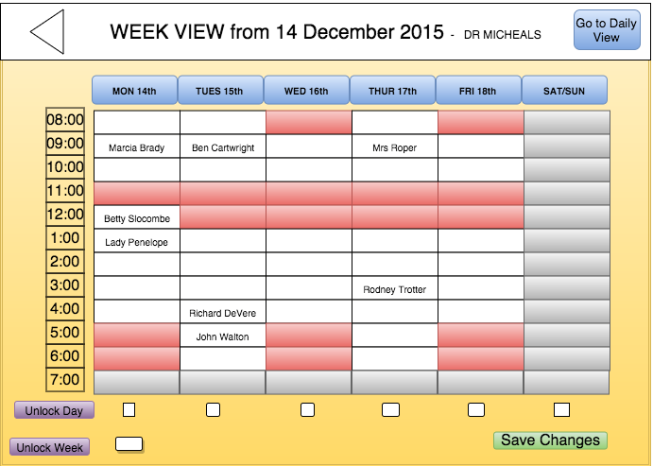

Slide 15
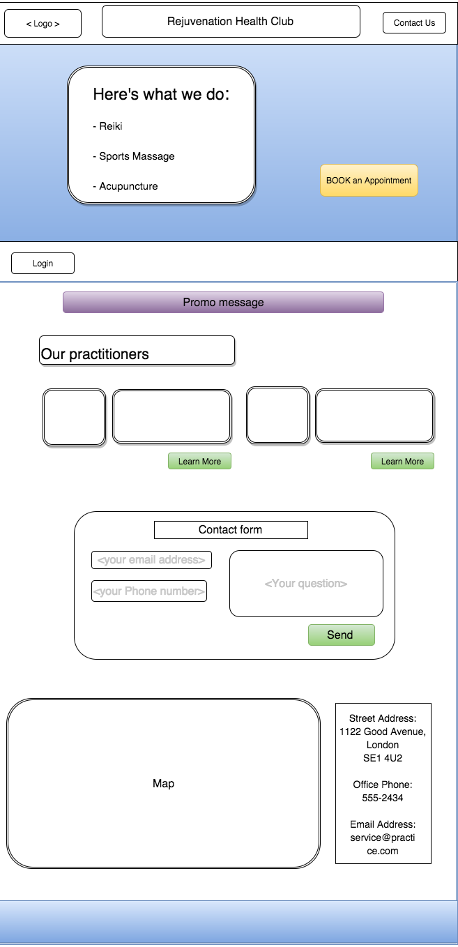

Slide 16
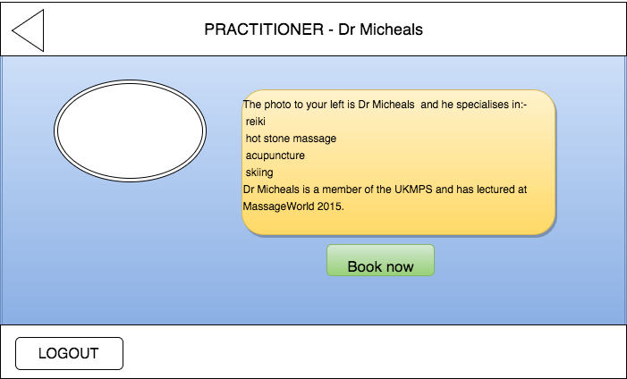
Additional slide 1- Practitioner Info.

Slide 17
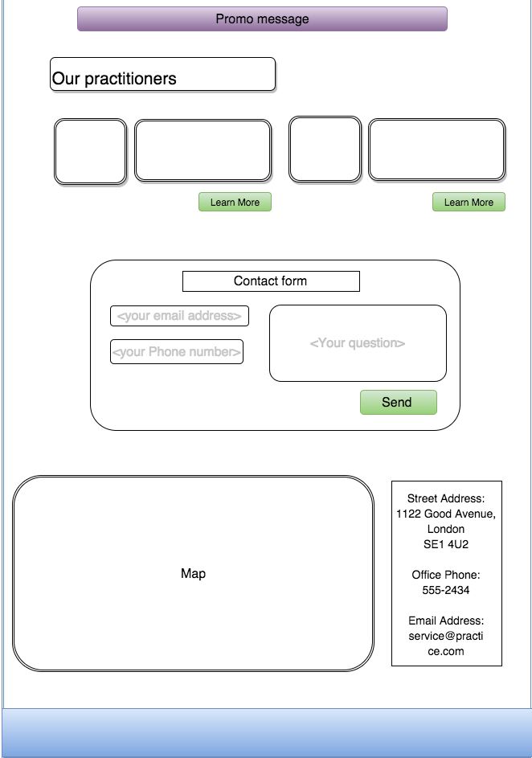

Slide 18
Web site creation
The creation of this booking system will make use of :-
React.js library
CSS (using SASS) styling.
A styling framework (such as Bootstrap or Foundation)
Browserify (front-end, for bundling modules of code together)
Node.js, MongoDB & Express.js for back-end storage
Firebase (Back-end storage)
Unit testing (using Jasmine)

Slide 19
Any Questions?

